Slide 1
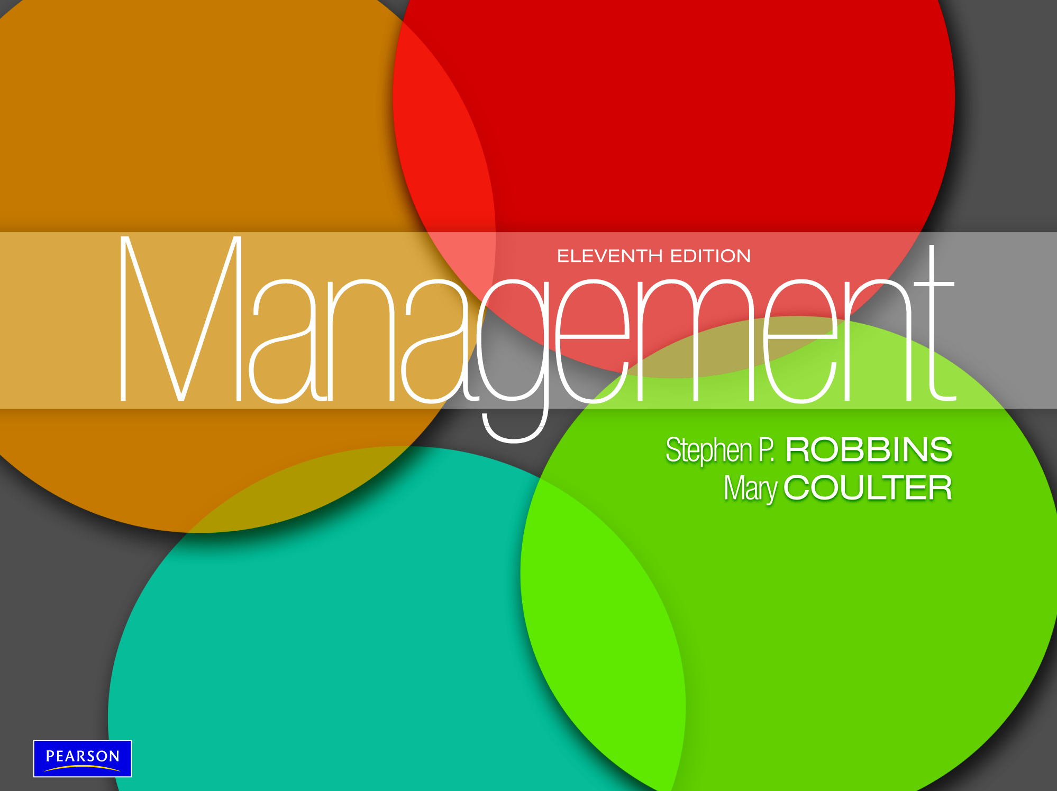

Slide 2
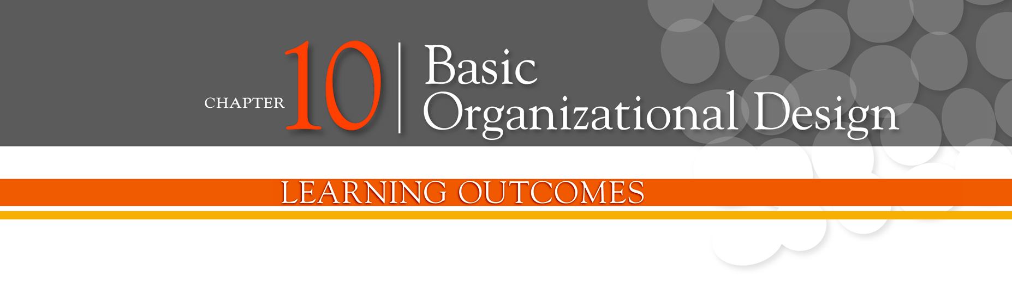
Describe six key elements in organizational design
Contrast mechanistic and organic structures
Discuss the contingency factors that favor either the mechanistic model or the organic model of organizational design
Describe traditional organizational designs

Slide 3
Designing Organizational Structure
Organizing - arranging and structuring work to accomplish an organization’s goals.
Organizational Structure - the formal arrangement of jobs within an organization.
Organizational Design - a process involving decisions about six key elements:
    Work specialization
    Departmentalization
    Chain of command
    Span of control
    Centralization and decentralization
    Formalization

Slide 4
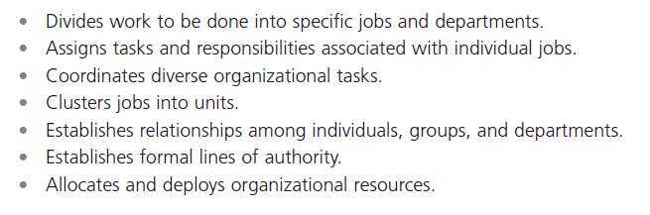
Exhibit 10-1: Purposes of Organizing
Notes:
Organizational structure is the formal arrangement of jobs within an organization. This structure, which can be shown visually in an organizational chart, also serves many purposes. (See Exhibit 10-1.)

Slide 5
Organizational Structure
Work Specialization:
is dividing work activities into separate job tasks with each step completed by a different person.
Individual employees “specialize” in doing part of an activity rather than the entire activity in order to increase work output. It’s also known as division of labor.
Work specialization makes efficient use of the diversity of skills that workers have.

Slide 6
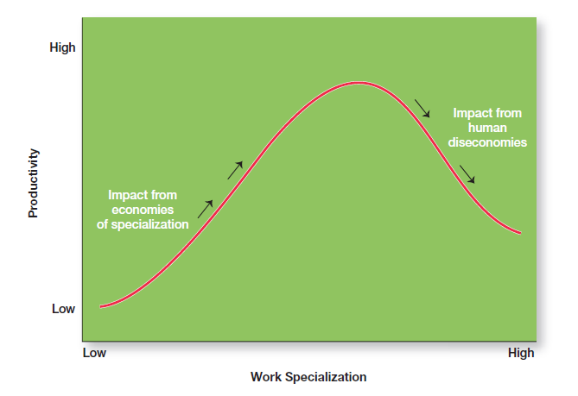
Exhibit 10-2: Economies and Diseconomies of Work Specialization
Notes:
As Exhibit 10-2 illustrates, at some point, the human diseconomies from division of labor—boredom, fatigue, stress, low productivity, poor quality, increased absenteeism, and high turnover—exceed the economic advantages.

Slide 7
Organizational Structure (cont.)
Departmentalization
is process of dividing work activities into units within the organization.
How jobs are grouped together is called departmentalization.
Five common forms of departmentalization are used, although an organization may develop its own unique classification.

Slide 8
Departmentalization by Type
Functional
  Grouping jobs by functions performed
Product
  Grouping jobs by product line
Geographical
  Grouping jobs on the basis of territory or geography
Process
  Grouping jobs on the basis of product or customer flow
Customer
  Grouping jobs by type of customer and needs

Slide 9
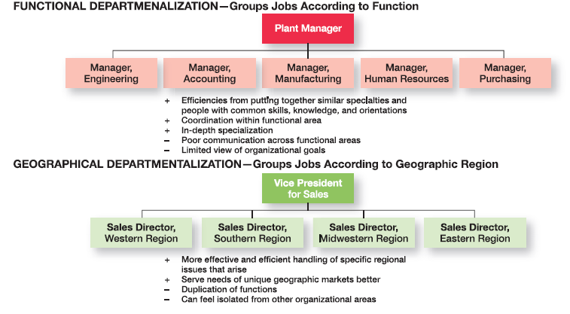
Exhibit 10-3: The Five Common
Forms of Departmentalization
Notes:
Five common forms of departmentalization are used, although an organization may develop its own unique classification. (For instance, a hotel might have departments such as front desk operations, sales and catering, housekeeping and laundry, and maintenance.) Exhibit 10-3 illustrates each type of departmentalization as well as the advantages and disadvantages of each.

Slide 10
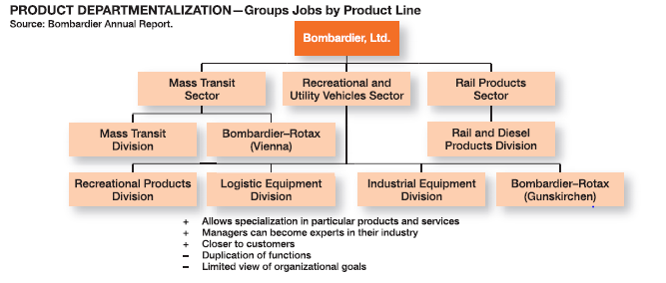
Exhibit 10-3: The Five Common Forms of Departmentalization (cont.)

Slide 11
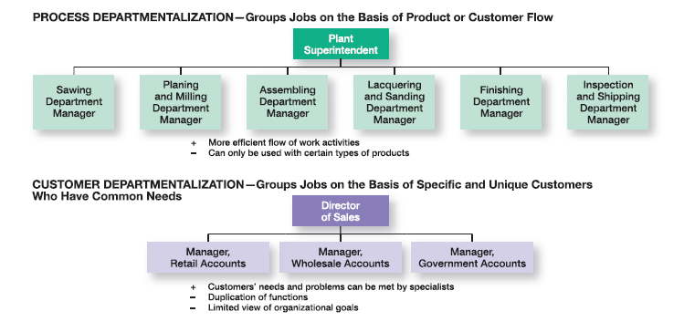
Exhibit 10-3: The Five Common Forms of Departmentalization (cont.)

Slide 12
Organizational Structure (cont.)
Chain of Command - the continuous line of authority that extends from upper levels of an organization to the lowest levels of the organization.
Managers need to consider it when organizing work because it helps employees with questions such as “Who do I report to?” or “Who do I go to if I have a problem?”
To understand the chain of command, you have to understand three other important concepts: authority, responsibility, and unity of command.

Slide 13
Organizational Structure (cont.)
Authority - the rights inherent in a managerial position to tell people what to do and to expect them to do it.
Responsibility - the obligation or expectation to perform.
Unity of Command - the concept that a person should have one boss and should report only to that person.

Slide 14
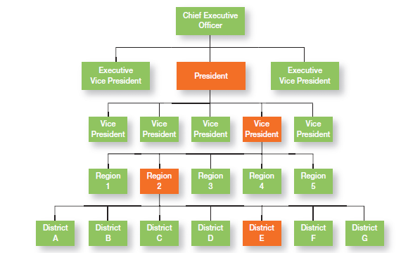
Exhibit 10-4: Chain of Command and Line Authority
Notes:
Line authority entitles a manager to direct the work of an employee. It is the employer-employee authority relationship that extends from the top of the organization to the lowest echelon, according to the chain of command, as shown in Exhibit 10-4.

Slide 15
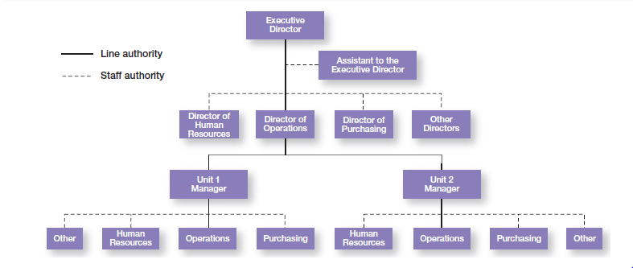
Exhibit 10-5: Line vs. Staff Authority
Notes:
Exhibit 10-5 illustrates line and staff authority.

Slide 16
Organizational Structure (cont.)
Span of Control
The number of employees who can be effectively and efficiently supervised by a manager.

Slide 17
Width of span is affected by:
    Skills and abilities of the manager
    Employee characteristics
    Characteristics of the work being done
    Similarity of tasks
    Complexity of tasks
    Physical proximity of subordinates
    Standardization of tasks
    Sophistication of the organization’s information system
    Strength of the organization’s culture
    Preferred style of the manager

Slide 18
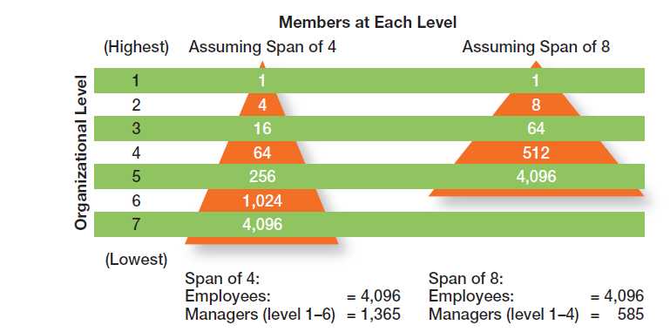
Exhibit 10-6: Contrasting Spans of Control
Notes:
Assume two organizations, both of which have approximately 4,100 employees. As Exhibit 10-6 shows, if one organization has a span of four and the other a span of eight, the organization with the wider span will have two fewer levels and approximately 800 fewer managers.

Slide 19
Centralization
Centralization - the degree to which decision making is concentrated at upper levels in the organization.
    This is common in organizations in which top managers make all the decisions and lower-level employees simply carry out those orders.

Slide 20
Decentralization
Decentralization - when an organization relegates decision making to managers who are closest to the action.
Employee Empowerment
  Increasing the decision-making authority (power) of employees

Slide 21
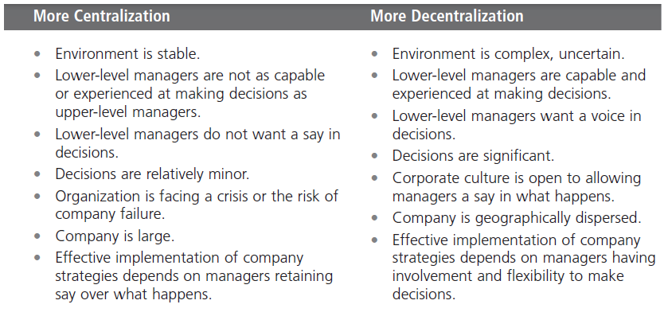
Exhibit 10-7: Centralization or Decentralization
Notes:
Exhibit 10-7 lists some of the factors that affect an organization’s use of centralization or decentralization.

Slide 22
Formalization
Formalization
the degree to which jobs within the organization are standardized and the extent to which employee behavior is guided by rules and procedures.

Slide 23
Exhibit 10-8: Mechanistic Versus
Organic Organizations
Developed by British theorists Tom Burns and George Stalker in their work titled The Management of Innovation (1961).
Notes:
Designing (or redesigning) an organizational structure that works is important. Basic organizational design revolves around two organizational forms that are described in Exhibit 10-8

Slide 24
Exhibit 10-8: Mechanistic Versus
Organic Organizations
Mechanistic organization (or bureaucracy) is Hierarchical, bureaucratic, organizational-structure characterized by:
  centralization of authority,
  formalization of procedures and practices, and
  specialization of functions.
Mechanistic organization are comparatively simpler and easy to organize, but find it difficult to cope with rapid change.
Notes:
Designing (or redesigning) an organizational structure that works is important. Basic organizational design revolves around two organizational forms that are described in Exhibit 10-8

Slide 25
Exhibit 10-8: Mechanistic Versus
Organic Organizations
Organic Structure is Organizational structure characterized by:
  Flatness: communications and interactions are horizontal,
  Low specialization: knowledge resides wherever it is most useful, and
  Decentralization: great deal of formal and informal participation in decision making.
Organic organizations are comparatively more complex and harder to form, but are highly adaptable, flexible, and more suitable where external environment is rapidly changing and is unpredictable.
Notes:
Designing (or redesigning) an organizational structure that works is important. Basic organizational design revolves around two organizational forms that are described in Exhibit 10-8

Slide 26
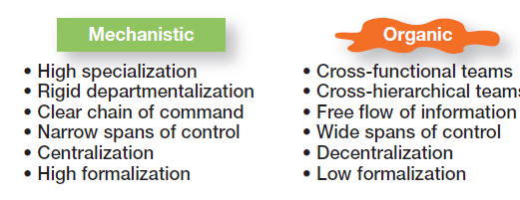
Exhibit 10-8: Mechanistic Versus
Organic Organizations
Notes:
Designing (or redesigning) an organizational structure that works is important. Basic organizational design revolves around two organizational forms that are described in Exhibit 10-8

Slide 27
Contingency Factors
Structural decisions are influenced by:
  Overall strategy of the organization
  Size of the organization
  Technology use employed by the organization
  Degree of environmental uncertainty

Slide 28
Contingency Factors (cont.)
Strategy and Structure
Strategy Frameworks:
  Innovation
    Pursuing competitive advantage through meaningful and unique innovations favors an organic structuring
  Cost minimization
    Focusing on tightly controlling costs requires a mechanistic structure for the organization

Slide 29
Contingency Factors (cont.)
Size and Structure
As an organization grows larger, its structure tends to change from organic to mechanistic with increased specialization, departmentalization, centralization, and rules/regulations.

Slide 30
Contingency Factors (cont.)
Technology and Structure
Organizations adapt their structures to their technology.
Woodward’s classification of firms based on the complexity of the technology employed:
    Unit production of single units or small batches
    Mass production of large batches of output
    Process production in continuous process of outputs
    Routine technology = mechanistic organizations
    Non-routine technology = organic organizations

Slide 31
Contingency Factors (cont.)
Environmental Uncertainty and Structure
  Mechanistic organizational structures tend to be most effective in stable and simple environments.
  The flexibility of organic organizational structures is better suited for dynamic and complex environments.

Slide 32
Traditional Designs
Simple structure
    Low departmentalization, wide spans of control, centralized authority, little formalization
Functional structure
    Departmentalization by function
    Operations, finance, marketing, human resources, and product research and development
Divisional structure
    Composed of separate business units or divisions with limited autonomy under the coordination and control of the parent corporation

Slide 33
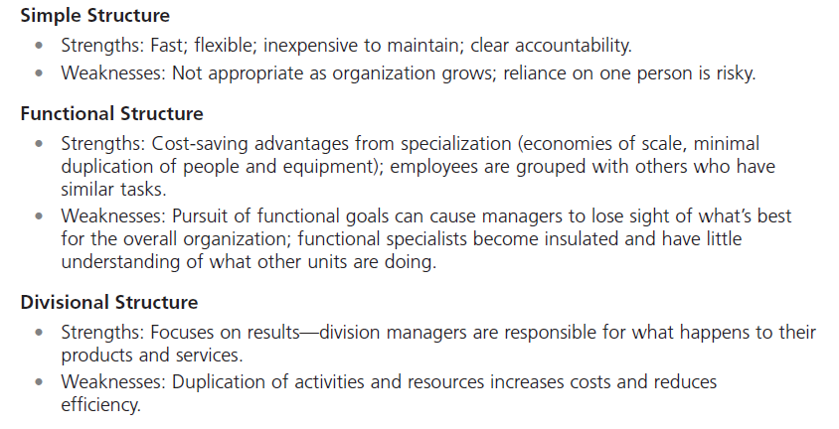
Exhibit 10-10: Traditional
Organizational Designs
Notes:
When designing a structure, managers may choose one of the traditional organizational designs. These structures tend to be more mechanistic in nature. A summary of the strengths and weaknesses of each can be found in Exhibit 10-10

Slide 34
Terms to Know
organizing
organizational structure
organizational chart
organizational design
work specialization
departmentalization
cross-functional teams
chain of command
authority
responsibility
unity of command
span of control
centralization
decentralization
employee empowerment
formalization
mechanistic organization
organic organization
unit production
mass production
process production
simple structure
functional structure
divisional structure
team structure
matrix structure
project structure
boundaryless organization
virtual organization
network organization
learning organization

Slide 35
